Slide 1


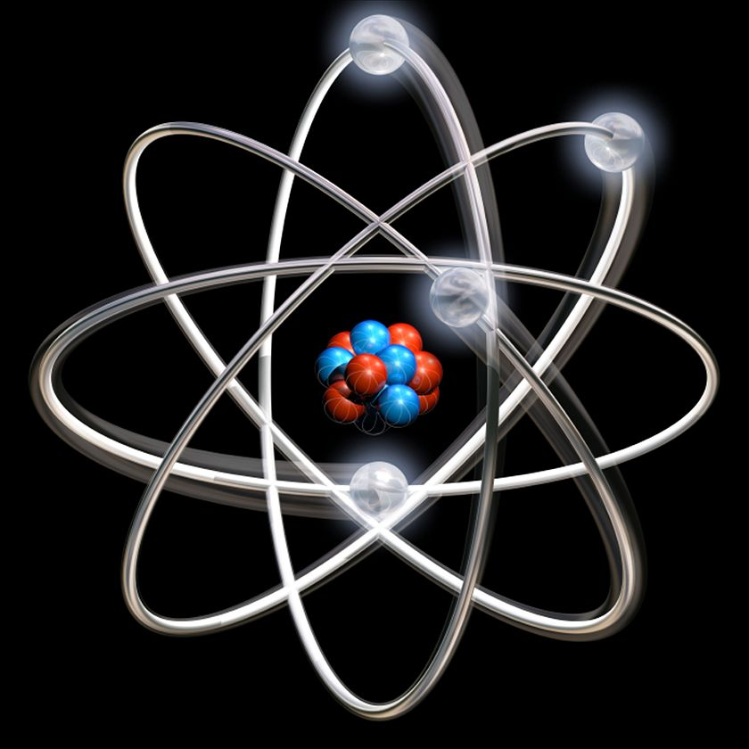
RV College of
Engineering
Unit-II
Quantum Mechanics
Quantum Mechanics

Slide 2

Go, change the world
RV College of
Engineering
Introduction
The principles of Classical mechanics and Maxwell's equations (electromagnetic theory) describe the ‘‘laws of Nature’’ in the macroscopic world i.e., world of large, heavy and slow bodies.
Classical mechanics, a successful theory till the end of 19th century, failed to explain the
Stability of atoms
Energy distribution in the black body radiation spectrum,
Origin of discrete spectra of atoms,
Photoelectric effect,
Compton Effect,
Raman Effect,
Quantum Hall effect,
Superconductivity etc.
The insufficiency of classical mechanics led to the development of quantum mechanics (QM).

Slide 3
Go, change the world
RV College of
Engineering
Quantum mechanics explain microscopic phenomena such as photon-atom scattering and flow of the electrons in a semiconductor etc
Materials and Technology
Evolution of the Universe
Atoms and Molecules
Subatomic Particles
Quantum Theory
Nuclear Physics
Quantum Optics
Power
Medical applications
Lasers & Communications
Quantum Computing
Quantum Cryptography

Slide 4
Go, change the world
RV College of
Engineering
Paradoxes ???
According to one definition, a paradox is a statement that seems self-contradictory or absurd but may be true; According to another, a paradox is a true self-contradiction and therefore false
A paradox can be useful in developing a physical theory; it can show that something is wrong even when everything appears to be right
A paradox can be useful in developing a physical theory; it can show that something is wrong even when everything appears to be right
Paradoxes in Quantum Mechanics
Light: Is it a wave or Particle
Schrodinger’s Cat
Measurement Problem
Many world Interpretation
Velocity of light & Time travel

Slide 5
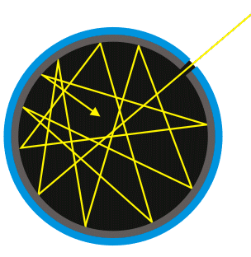
Go, change the world
RV College of
Engineering
Break down of classical mechanics
Black Body radiation spectrum
Black-body → An idealized, perfectly opaque material that absorbs all incident radiation at all frequencies, and reemits it to stay in thermodynamic equilibrium at temperature T.
Black-body radiation → electromagnetic radiation emitted by a black body held at constant, uniform temperature.
In nature there are no perfect black bodies.

Slide 6
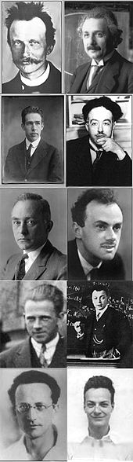
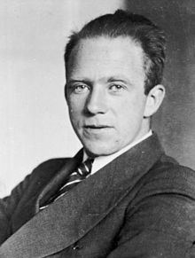
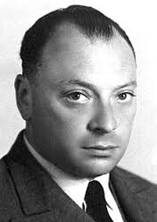
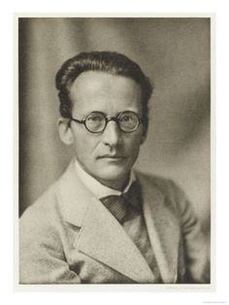
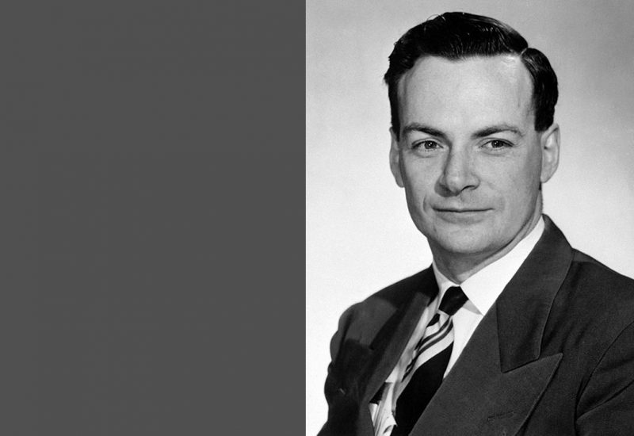
Go, change the world
RV College of
Engineering
Great minds behind Quantum theory development - 1900 and 1930
Max Planck
Albert Einstein
Neils Bohr
Louis de Broglie
Max Born
Paul Dirac
Werner Heisenberg
Wolfgang Pauli
Erwin Schrodinger
Richard Feynman

Slide 7
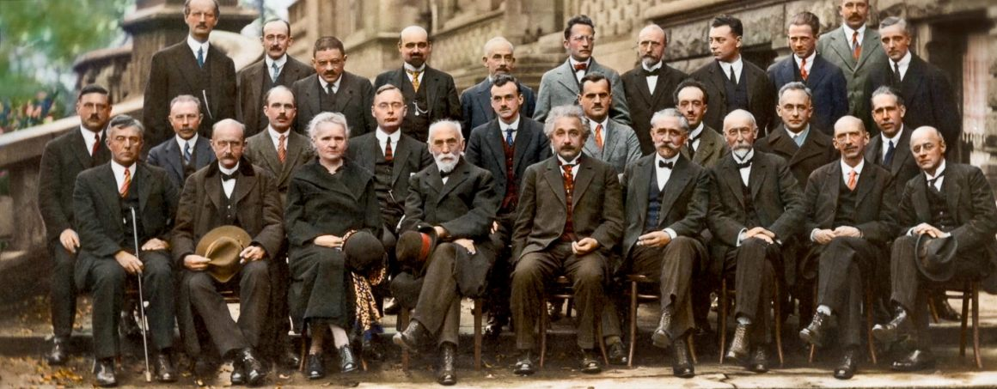
Go, change the world
RV College of
Engineering
Solvay Conference - 1927
Where world's brightest scientific minds carried out the historic debates about
quantum mechanics
Piccard, E. Henriot, P. Ehrenfest, E. Herzen, Th. de Donder, E. Schrödinger, J.E. Verschaffelt, W. Pauli, W. Heisenberg, R.H. Fowler, L. Brillouin; P. Debye, M. Knudsen, W.L. Bragg, H.A. Kramers, P.A.M. Dirac, A.H. Compton, L. de Broglie, M. Born, N. Bohr;I. Langmuir, M. Planck, Marie Curie, H.A. Lorentz, A. Einstein, P. Langevin, Ch.-E. Guye, C.T.R. Wilson, O.W. Richardson
Fifth conference participants, 1927. Institut International de Physique Solvay in Leopold Park.

Slide 8
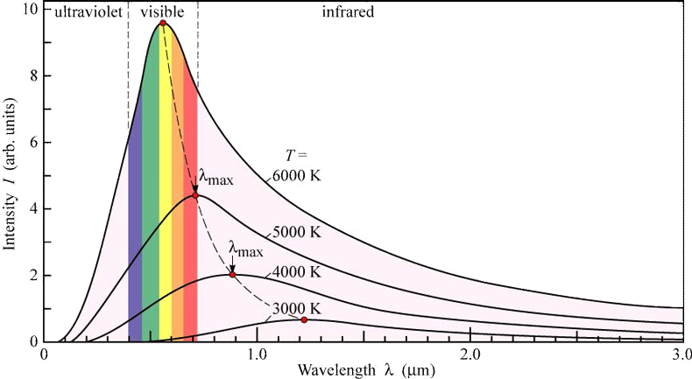
Go, change the world
RV College of
Engineering
Black Body Spectrum:
Energy vs wavelength of black body radiations
Experimental observation
At room temperature, black bodies emit IR light,
On increase in temperature emission spectrum shifts to visible wavelengths (red to blue),
Beyond which the emission includes increasing amounts of UV

Slide 9
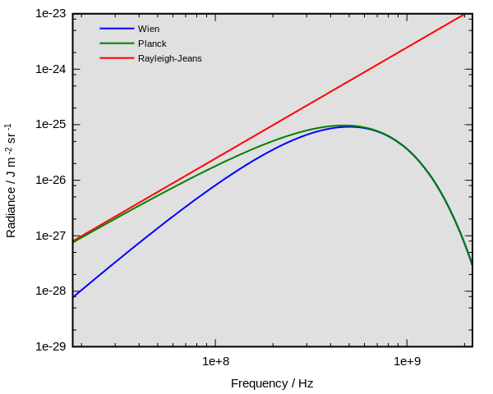
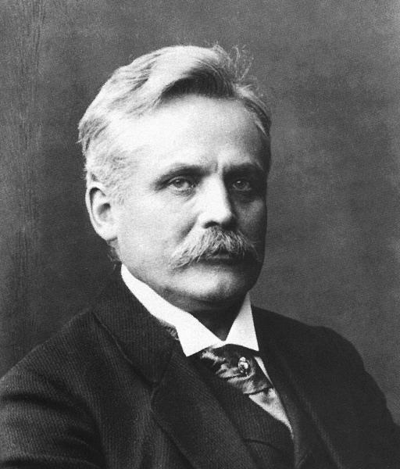
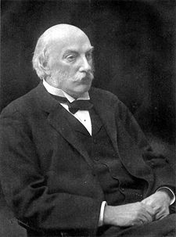
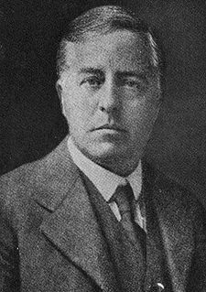
Go, change the world
RV College of
Engineering
On theoretical side:
The energy distribution in the black body spectrum was explained by Wien’s distribution law and Rayleigh Jeans law
Experimental
Wien’s Law
Rayleigh – Jean’s Law
Wien’s Law 1896 - successfully explained lower
wavelength region of BB spectrum
WILHELM WIEN
(1864 – 1928)
Rayleigh–Jeans Law (1900 – 1905) – explains the higher wavelength region of BB spectrum.
John William Strutt,
3rd Baron Rayleigh
1842- 1919
James Hopwood Jeans
1877 - 1946

Slide 10
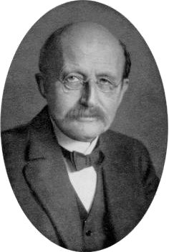
Go, change the world
RV College of
Engineering
The solution….Planck’s Law
Planck assumed that the radiation in the blackbody was emitted/absorbed by oscillators contained in the walls.
Planck deviated from the concepts of classical physics by assuming that the energy of the oscillators, to be varying in certain discrete values than continuously.
where n is an integer (n = 0, 1, 2, …), and h =6.6260.10⁻³¹ Js is the Planck’s Constant.
Max Planck
Based on the idea of “quantum” of energy Planck derived the relation empirically for spectral density of electromagnetic radiation emitted by a black body in thermal equilibrium at a given temperature T.
Where k - Boltzmann’s constant;
h- Planck’s constant, c -velocity of light, λ - wavelength of the black-body radiation and
ν - angular frequency of radiation

Slide 11
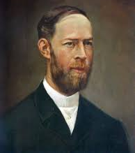
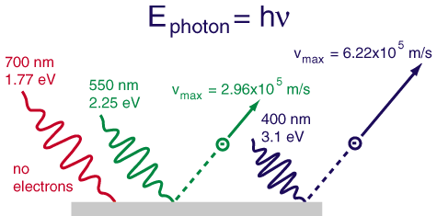
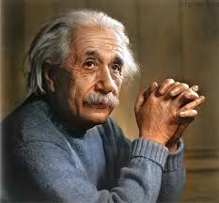
Go, change the world
RV College of
Engineering
Photoelectric Effect (1887-1905): Discovered by Hertz in 1887 and explained in 1905 by Einstein.
Heinrich Hertz
Albert Einstein
Nobel Prize in 1921
Einstein successfully explained the Photoelectric Effect by applying Planck’s quantum theory i.e electromagnetic energy occurs in small packets called quanta or photons , E = hν

Slide 12

Go, change the world
RV College of
Engineering
If light shines on the surface of a metal, there is a frequency called Threshold frequency, above which electrons are ejected from the metal.
Below the threshold frequency, no electrons are ejected.
Above the threshold frequency, the number of electrons ejected depend on the intensity of the light
Einstein’s photoelectric equation:
A part of its energy is used to free the electron from the atoms of the metal surface.
This energy is known as a photoelectric work function of metal (W_{o})
ii) The other part is used in giving kinetic energy (½ mv²) to the electron.
where ‘v’ is the velocity of the emitted electron.
Threshold frequency (ν₀) - The minimum frequency which can cause photoelectric emission. Below this frequency no emission of electron takes place.

Slide 13
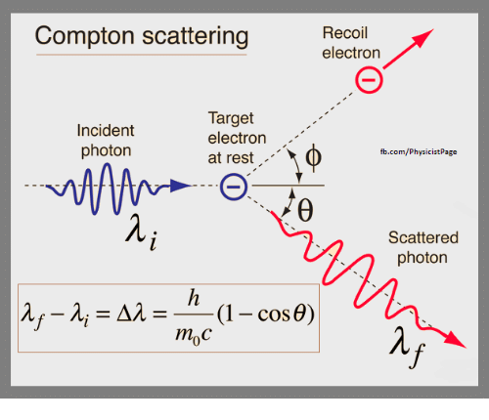
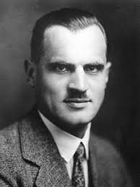
Go, change the world
RV College of
Engineering
Compton Effect
Compton scattering → Scattering of a photon (X-ray or gamma ray photon) by a free particle like electron
Compton effect – Phenomena of decrease in energy (increase in wavelength) of the Compton scattered photon .
Part of the energy of the photon is transferred to the recoiling electron.
The amount by which the light's wavelength changes is called the Compton shift. Mathematical expression for the shift was derived by Compton considering incident radiation as a particle.
Compton effect is the most conclusive evidence of particle nature of Electromagnetic radiation and an important verification of the quantum theory.
Sir Arthur H Compton
Nobel Prize 1927

Slide 14
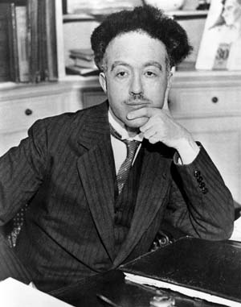
Go, change the world
RV College of
Engineering
MATTER WAVES
In 1924 Louis de Broglie extended the wave particle dualism of radiation to fundamental entities of physics, such as electrons, protons, neutrons, atoms, molecules, etc. with the wavelength λ related to momentum p in the same way as for light
de Broglie
de Broglie Hypothesis of matter waves
1. In nature energy manifests itself in two forms, namely matter and radiation.
2. Nature loves symmetry.
3. As radiation can act like both wave and a particle, material particles(like electrons, protons, etc.) in motion should exhibit the property of waves.
Planck’s constant
de Broglie wavelength
Experimental confirmation
Davisson-Germer experiment for electrons
George Paget Thomson's cathode ray diffraction experiment

Slide 15
Go, change the world
RV College of
Engineering
de-Broglie Wavelength of matter waves
The concept of matter waves is well understood by combining Planck’s quantum theory and Einstein’s theory.
Planck’s theory
Einstein’s mass-energy relation
p → momentum of the photon and h is a Planck’s constant.
do-Broglie hypothesis → matter also show dual nature.
Hence for a particle of mass ‘m’ moving with a velocity ‘v’ and momentum ‘p’. the wavelength ‘λ’ of matter waves is given by
de-Broglie wavelength.

Slide 16
Go, change the world
RV College of
Engineering
De-Broglie wavelength of an electron
Consider an electron of mass ‘m’ accelerated from rest by an electric potential ‘V’. The electrical work done (eV) is equal to the kinetic energy E gained by the electron.
kinetic energy of electron
From de-Broglie wavelength
Therefore
electrical work done
On substituting for E we get

Slide 17
Go, change the world
RV College of
Engineering
de-Broglie wavelength of an electron contd…
Substituting the values of e, m and h, to the following equation we get
de-Broglie wavelength of an electron
de-Broglie wavelength of a particle of charge ‘q’ accelerated through a potential difference ‘V’,

Slide 18
Go, change the world
RV College of
Engineering
Properties/characteristics of matter waves
Waves associated with moving particles are called matter waves. de-Broglie wavelength (λ) of the matter wave is given by
Lighter the particle, greater would be the wavelength of matter waves associated with it.
Lesser the velocity of the particle, greater would be the wavelength.
For p = 0 or v=0, λ is infinity ie., the wave becomes indeterminate. This means that matter waves are associated with moving particles only.
A particle is a localized mass and a wave is a spread out disturbance. So, the wave nature of matter introduces a certain uncertainty in the position of the particle.
The wave and particle nature are not exhibited simultaneously.
Matter waves are probability waves because waves represent the probability of finding a particle in space.
Matter waves | Electromagnetic Waves
Produced by charged or uncharged particles in motion. | Produced only by a moving charged particle
In an isotropic medium wavelength of a matter wave changes with the velocity of the particle | In an isotropic medium the wavelength of an electromagnetic wave remains constant
Hence matter waves are non- electromagnetic waves.

Slide 19
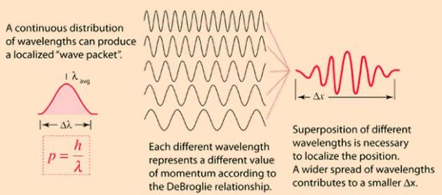
RV College of
Engineering
Go, change the world
Wave packet → probability amplitude
wave packet ⇔ wave group → Represents the probability of finding a particle.
When a group of two or more waves, differing slightly in wavelengths are superimposed on each other, a resultant pattern emerges in the shape of variation in amplitude.
Phase velocity : The velocity with which planes of constant phase moves
ω → angular frequency k →2π/ λ → wave vector
Group velocity: The velocity with which the envelope of waves (wave packet) formed due to superposition of two or more progressive waves of slightly different wavelengths is called group velocity
v_{g} is usually different from the individual phase velocities of the waves that make up the packet.

Slide 20
Relation between group velocity (v_{g}) and phase velocity (v_{p})
Relation between group velocity (v_{g}) and particle velocity (v_{particle})
From Planck’s theory and de-Broglie wavelength
we know that
E and p are the Energy, and momentum of the particle respectively
using the above relations in group velocity we get
On substituting we get
for a non relativistic free particle,
the group velocity equals the particle velocity,
the phase velocity is equal to half of group velocity.

Slide 21
RV College of
Engineering
Go, change the world
Relation between group velocity (v_{g}), phase velocity (v_{p}) and light velocity (c)
(relativistic case)
we know that
On substituting for E and p we get
Since v_{g} = v_{particle} and the velocity of material particle (v_{p}) can never be greater than or even equal to velocity of light (c)
V_{phase} is always greater than c

Slide 22
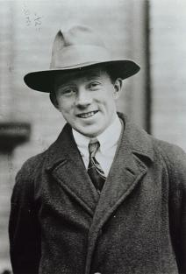
Go, change the world
RV College of
Engineering
Heisenberg Uncertainty Principle
Heisenberg’s Uncertainty Principle is one of the most celebrated results of quantum mechanics.
Heisenberg Uncertainty Principle states
“It is impossible to specify precisely and simultaneously certain pairs of physical quantities like position and momentum that describe the behavior of an atomic system”.
Quantitatively
Werner Heisenberg
Nobel Prize (1932)
“in any simultaneous measurement the product of the magnitudes of the uncertainties of the pairs of physical quantities is equal to or greater than h/4π “
Δp • Δx ≥ h/4π
ΔE • Δt ≥ h/4π
ΔJ • Δθ ≥ h/4π
Δp uncertainty in momentum
Δx uncertainty in position
ΔE uncertainty in Energy
Δt uncertainty in time
ΔJ uncertainty in angular momentum
Δθ uncertainty in Angular displacement
The uncertainty principle is inherent in the properties the quantum systems owing to their wave-particle duality and is not a inadequacy of current technology.

Slide 23

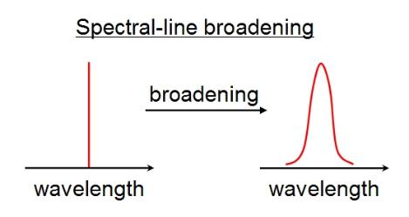
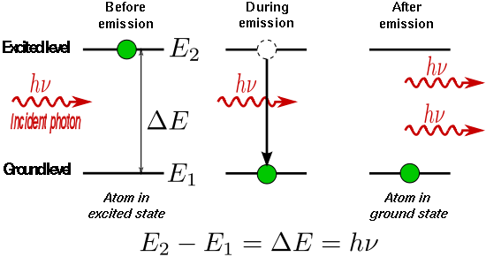
Go, change the world
RV College of
Engineering
2. Broadening of spectral lines - Absorption and emission of radiation
E₂
E₂
Δλ=0
= E₂-E₁
= E₂-E₁
E₁
E₁
Absorption
Excitation
Emission
Δλ=FWHM
E₂
E₂
Δλ
= E₂-E₁
= E₂-E₁
E₁
E₁
Absorption
Excitation
Emission

Slide 24
Go, change the world
RV College of
Engineering
The energy of the emitted photon is given by
On differentiating equation (1) with respect to λ
From Heisenberg’s uncertainty principle, uncertainty in the energy of the emitted photon corresponding to finite lifetime Δt of the excited state is
Substituting for ΔE and applying the condition of minimum uncertainty, we get
for a finite lifetime of the excited state, the emitted photon wavelength will have a spread of wavelengths around the mean value λ.
For narrow Δλ ,the lifetime of the excited state must be very high (of the order of 10⁻³s) known as Metastable states. This concept is adopted in the production of laser light.

Slide 25
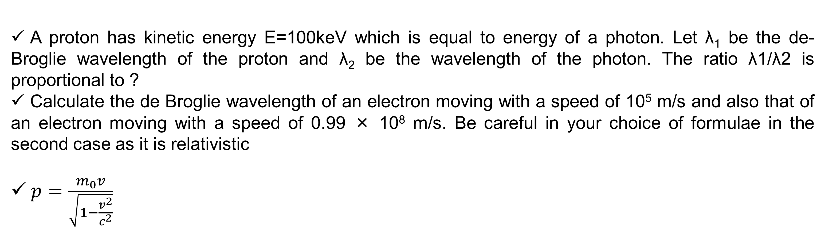
Go, change the world
RV College of
Engineering
A proton has kinetic energy E=100keV which is equal to energy of a photon. Let λ₁ be the de-Broglie wavelength of the proton and λ₂ be the wavelength of the photon. The ratio λ1/λ2 is proportional to ?
Calculate the de Broglie wavelength of an electron moving with a speed of 10⁵ m/s and also that of an electron moving with a speed of 0.99 × 10⁸ m/s. Be careful in your choice of formulae in the second case as it is relativistic
$p=\frac{m_{0}v}{\sqrt{1−\frac{v^{2}}{c^{2}}}}$
An enclosure filled with helium is heated to 400K. A beam of He-atoms emerges out of the enclosure. Calculate the de-Broglie wavelength corresponding to He atoms. mass_{He} is 6.7 * 10⁻²⁷ kg
An electron beam is accelerated from rest through a potential difference of 200V
Calculate the associated wavelength
This beam is passed through a diffraction grating of spacing 3Ǻ. At what angle of deviation from the incident direction will be the first maximum observed
Calculate the de-Broglie wavelength of neutron of energy 12.8 MeV, mass _{neutron}= 1.67 *10⁻²⁷kg

Slide 26
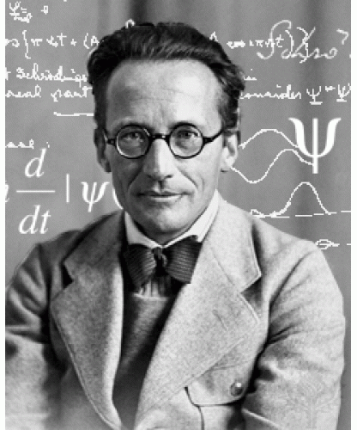
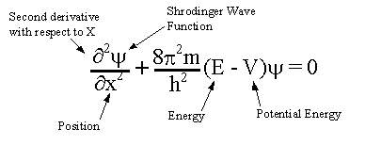
Go, change the world
RV College of
Engineering
Schrödinger’s Wave Equation
A consequence of wave particle duality
The Schrödinger wave equation, a partial differential equation, is the fundamental
equation of physics for describing quantum mechanical behavior.
It describes the time-evolution of wave function for a given physical system.
SWE is the quantum mechanics analogue to the Newton's laws of motion.
SWE cannot be derived from any basic principles, but can be arrived at, by using the de-Broglie hypothesis in conjunction with the classical wave equation
Erwin Schrödinger
Nobel Prize 1933
A wave function in quantum physics is a mathematical description of the quantum state of a system, whose variation gives matter waves

Slide 27
Go, change the world
RV College of
Engineering
Time Independent one dimensional Schrödinger wave equation (TISE)
Let ψ(x,t) be the wave function of the matter wave associate with a particle of mass ‘m’ moving with a velocity ‘v’. The differential equation of the wave motion is as follows.
The solution of the Eq.(1) as a periodic displacement of time ‘t’ is
ψ(x,t) =ψ₀(x) e^{-iωt} …..(2)
ψ₀(x) → amplitude of the matter wave
Differentiating Eq.(2) partially twice w.r.t. ‘t’, we get
Let us substitute Eq.(3) in Eq.(1)

Slide 28
Go, change the world
RV College of
Engineering
We know that
Substituting this in Eq4, we get
From de-Broglie wavelength we have
The kinetic energy of the particle with total energy E and potential energy V is
Substituting this in Eq.7, we get the

Slide 29
Go, change the world
RV College of
Engineering
Schrödinger time- independent one dimensional wave equation
Here ψ is a function of x alone and is independent of time

Slide 30
Go, change the world
RV College of
Engineering
Physical significance of the wave function
The wave function ψ(x, t) is the solution of Schrödinger wave equation and quantum-mechanically
describes the behavior of a moving particle.
The wave function ψ cannot be measured directly by any physical experiment.
ψ gives a measure of the probability of finding a particle at a particular position. ψ is also
called the probability amplitude.
Itself has no physical meaning as it is complex and non observable
The probability density P (x,t) , product of the wave function ψ and its complex conjugate ψ*, is a
measure of probability density i.e., probability per unit volume of the particle being at a point.

Slide 31
Go, change the world
RV College of
Engineering
Normalization of wave function
Consider a particle, represented by the wave function ψ, to be present in in a volume τ
If |ψ|² dτ is the probability of finding the particle in a small volume dτ then
total probability of finding a particle anywhere inside volume τ must be 1 i.e.,
This requirement is known as the Normalisation condition.
In one dimension the normalization condition is
Note: When the particle is bound to a limited region the probability of finding the particle at infinity is zero i.e.,

Slide 32
Go, change the world
RV College of
Engineering
Properties of wave function
The wave function ψ should satisfy the following properties to describe the characteristics of matter waves.
1. ψ must be a solution of Schrödinger wave equation.
a
b
2. The wave function ψ should be continuous and single valued everywhere
ψ(x)
ψ(x)
3. Ψ is finite everywhere
P
x
P
x
4. The first derivative of ψ with respect to x should be continuous and single valued everywhere, since it is related to the momentum of the particle which should be finite.
c
ψ(x)
d
ψ(x)
5. Ψ must be normalized so that ψ must go to 0 as x → ± ∞ , so that ∫ψ² dτ over all the space be a finite constant.
x
Q
x
R
Figure b, c, and d do not represent wave functions

Slide 33
Go, change the world
RV College of
Engineering
Eigen functions and Eigen values
The physically acceptable solutions of SWE are called Eigen functions (ψ).
The physically acceptable wave functions ψ has to satisfy the following conditions:
1. ψ is single valued.
2. ψ and its first derivative with respect to its variable are continuous everywhere.
3. ψ is finite everywhere
Eigen values: The eigen functions are used in Schrödinger wave equation to evaluate the physically measurable quantities like energy, momentum, etc., these values are called Eigen values.
In an operator equation where is an operator for the physical quantity and ψ is an Eigen function and λ is the Eigen value.
For example :
H → total energy (Hamiltonian) operator, ψ → Eigen function and E → total energy in the system.
for the momentum
P → momentum operator and p → momentum eigen values.

Slide 34
Go, change the world
RV College of
Engineering
Applications of Schrodinger’s wave equation
1. Particle in an one-dimensional potential well of infinite depth (Particle in a box)
Let us start with a particle of mass ‘m’ moving freely in x- direction in the region from x=0 to x=a.
The potential energy V(x) = ∞ for x<0 and x>a
V(x) = 0 for 0 ≤ x ≤ a
Outside the box Schrodinger’s wave equation is
Where ψ =0 for all points outside the box i.e.,
⇒ particle cannot be found at all outside the box
Inside the box V = 0, the Schrodinger’s equation is given by,
∞
∞
Region I
Region II
Region III
V=∞
V=0
V=∞
where
The solution of equation (2) is
x=0
x
x=a
where A & B are constants which depends on the boundary conditions of the well.

Slide 35
Go, change the world
RV College of
Engineering
Applying boundary conditions
Condition: I at x =0, ψ = 0.
Substituting the condition I in SWE solution, we get A =0 and B≠0
(If both A and B = zero for all values of x, then ψ is zero. Which means the particle is not present in the well)
equation (3) can be written as
Condition: II at x =a, ψ = 0
Substituting the condition II in Eq (5) we get
0= B sin(ka)
since B ≠ 0
where, n = 1,2,3…………….

Slide 36
Go, change the world
RV College of
Engineering
Now we have
On equating and simplifying we get
The above equation gives the energy values or Eigen values of the particle in the well.
When n=0, ψ_{n} = 0. This means to say that the particle is not present inside the box, which violates our initial assumption. Hence n≠0 and the lowest value of ‘n’ is 1.
∴ The lowest energy corresponds to ‘n’=1 is called the zero-point energy or Ground state energy.
All the states of n > 1 are called excited states.

Slide 37
Go, change the world
RV College of
Engineering
Now its time to evaluate B by normalization of wave function.
Normalization of wave function ψ:
As there is only one particle within the box, the probability of finding the particle is 1.

Slide 38
Go, change the world
RV College of
Engineering
Thus the normalized wave function of a particle in a one-dimensional box is given by,
where, n=1,2,3……………
This equation gives the Eigen functions of the particle in the box. The Eigen functions for n=1,2,3.. are as follows.

Slide 39
Go, change the world
RV College of
Engineering
Eigen functions and Eigen values
Case (1): n=1.
Ground state and the particle is normally found in this state.
For n=1, the Eigen function is
x=0 x=a/2 x=a
Ψ₁ =0 at x=0 & x=a
Ψ₁ has a maximum value for x=a/2.
|ψ₁|² → the probability density
|ψ₁|² =0 at x = 0 and x = a,
|ψ₁|² is maximum at x = (a/2)
x=0 x=a/2 x=a
At ground state the particle cannot be found at the walls of the box and the probability of finding the particle is maximum at the central region.
The Energy in the ground state is given by

Slide 40
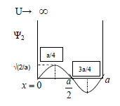
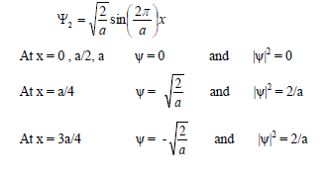
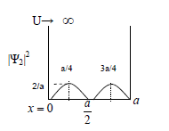
Go, change the world
RV College of
Engineering
Case 2: n =2 → the first excited state.
The Eigen function for this state is given by
In the first excited state the particle cannot be observed either at the walls or at the center
The energy is E₂ = 4E₁

Slide 41
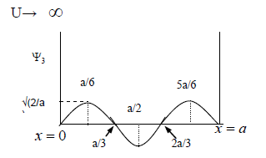
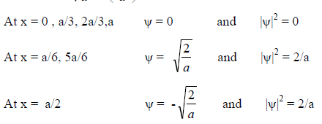
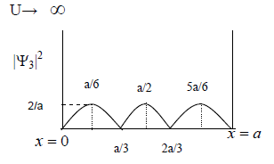
Go, change the world
RV College of
Engineering
Case 3: n =3 the second excited state
The eigen function for this state is given by
|ψ₃|² = 0 for the values x = 0, a/3, 2a/3, a and |ψ₃|² reaches maximum 2/a at x = a/6, a/2, 5a/6 at which the particle is most likely to be found.
The energy corresponding to second excited state → E₃=9E₁

Slide 42
Go, change the world
RV College of
Engineering
Applications of Schrodinger’s wave equation contd…
2. Free Particle:
A particle, which is not under the influence of any kind of field or force.
Thus, it has zero potential, i.e., V=0 over the entire space.
Hence Schrodinger’s equation becomes,
The above equation holds good for a particle for which the potential V=0 over the entire space
Let us extend the case of particle in an infinite potential well to the free particle case, by treating the width of the well to be infinity, i.e., by allowing a =∞
where n = 1, 2, 3…

Slide 43
Go, change the world
RV College of
Engineering
Text Books
1 | A Text book of Engineering Physics Dr. M N Avadhanulu, Dr. P. G. Kshirsagar, S. Chand & Company Private limited. Revised edition 2015
2 | Engineering Physics R K Gaur and S L Gupta, Dhanpat Rai Publications, Revised edition 2011.
3 | Engineering Physics S P Basavaraju
Reference Books
1 | Fundamentals of Physics Haliday & Resnic & Walker, John Wiley & Sons 2010, ISBN: 9971-51-330-7.
2 | Concepts of Modern Physics Arthur Beiser, Tata McGraw-Hill edition

